Slide 1
Chapter 29 Weighted Graphs and Applications

Slide 2
Objectives
To represent weighted edges using adjacency matrices and adjacency lists (§29.2).
To model weighted graphs using the WeightedGraph class that extends the AbstractGraph class (§29.3).
To design and implement the algorithm for finding a minimum spanning tree (§29.4).
To define the MST class that extends the Tree class (§29.4).
To design and implement the algorithm for finding single-source shortest paths (§29.5).
To define the ShortestPathTree class that extends the Tree class (§29.5).
To solve the weighted nine tail problem using the shortest-path algorithm (§29.6).

Slide 3
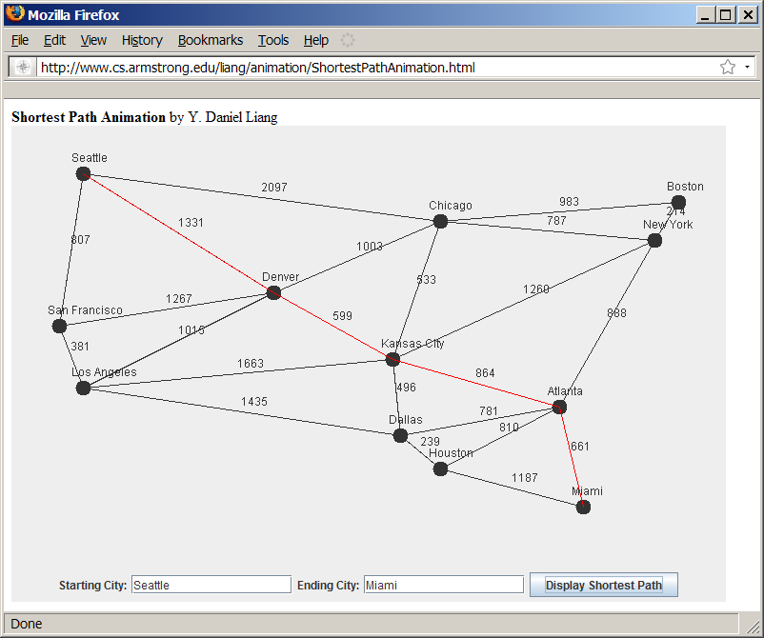
Weighted Graph Animation
www.cs.armstrong.edu/liang/animation/ShortestPathAnimation.html

Slide 4
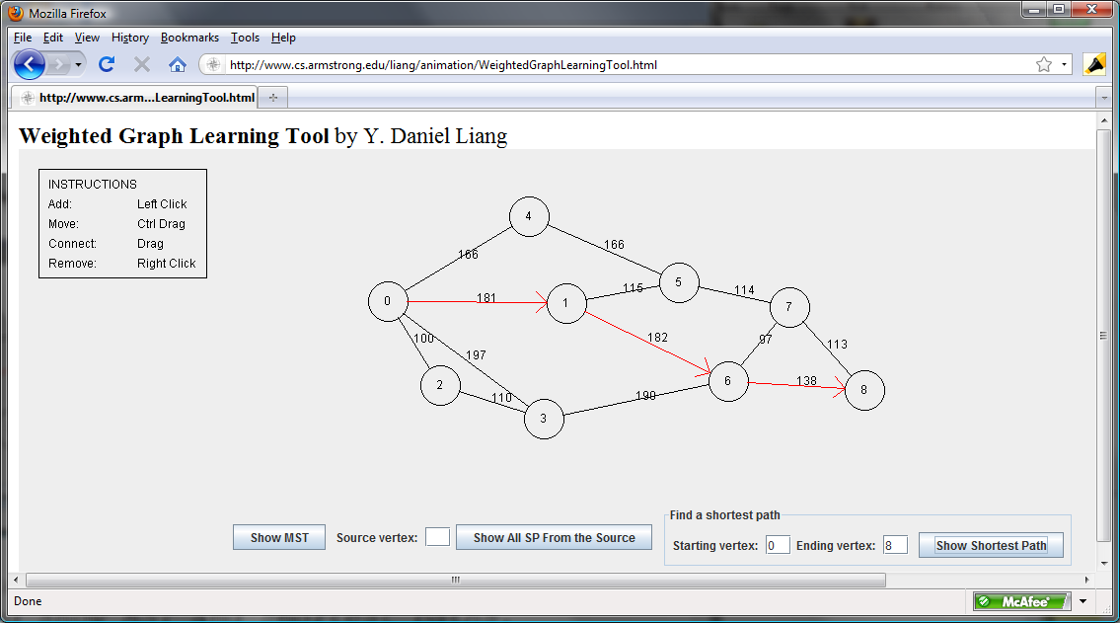
Weighted Graph Animation
www.cs.armstrong.edu/liang/animation/WeightedGraphLearningTool.html

Slide 5
Representing Weighted Graphs
Representing Weighted Edges: Edge Array
Weighted Adjacency Matrices
Adjacency Lists

Slide 6
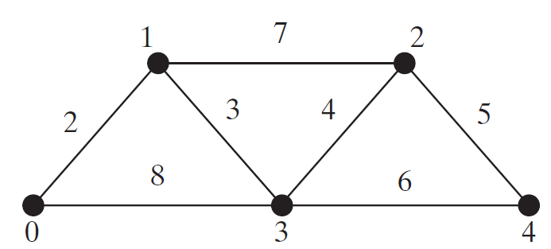
Representing Weighted Edges: Edge Array
int[][] edges = {{0, 1, 2}, {0, 3, 8},
{1, 0, 2}, {1, 2, 7}, {1, 3, 3},
{2, 1, 7}, {2, 3, 4}, {2, 4, 5},
{3, 0, 8}, {3, 1, 3}, {3, 2, 4}, {3, 4, 6},
{4, 2, 5}, {4, 3, 6}
};

Slide 7
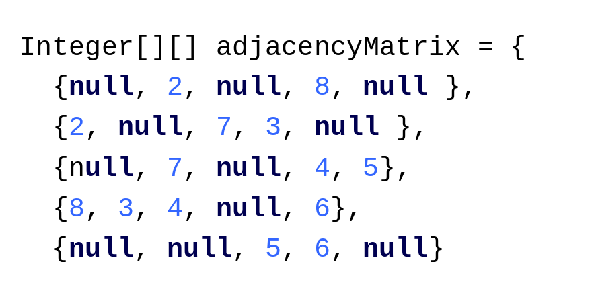
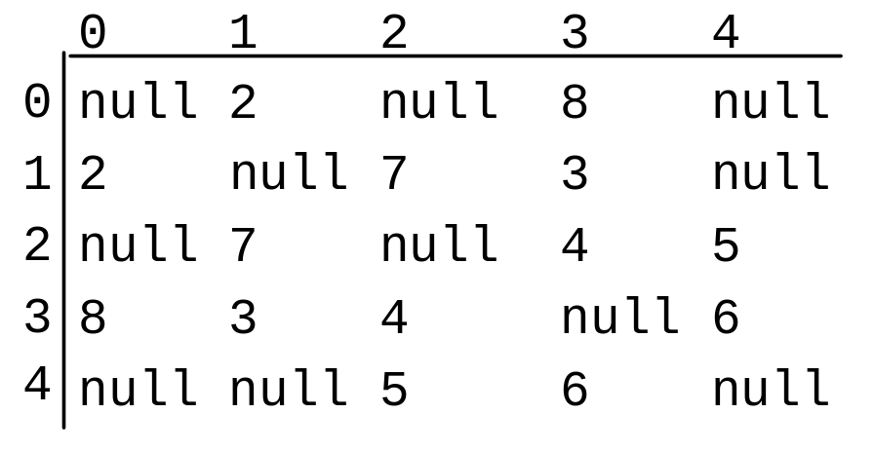
Representing Weighted Edges: Edge Array

Slide 8
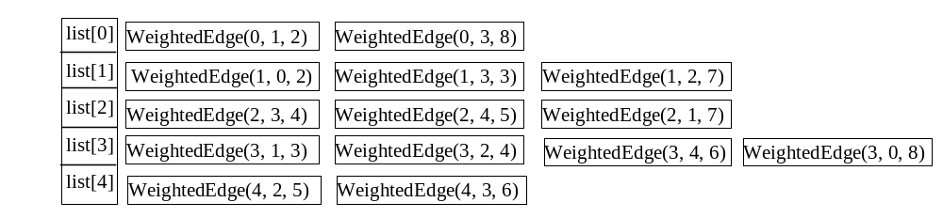
Edge Adjacency Lists
java.util.List<WeightedEdge>[] list = new java.util.List[5];
WeightedEdge

Slide 9
Edge Adjacency Lists
For flexibility, we will use an array list rather than a fixed-sized array to represent list as follows:
List<List<WeightedEdge>> list = new java.util.ArrayList<>();

Slide 10
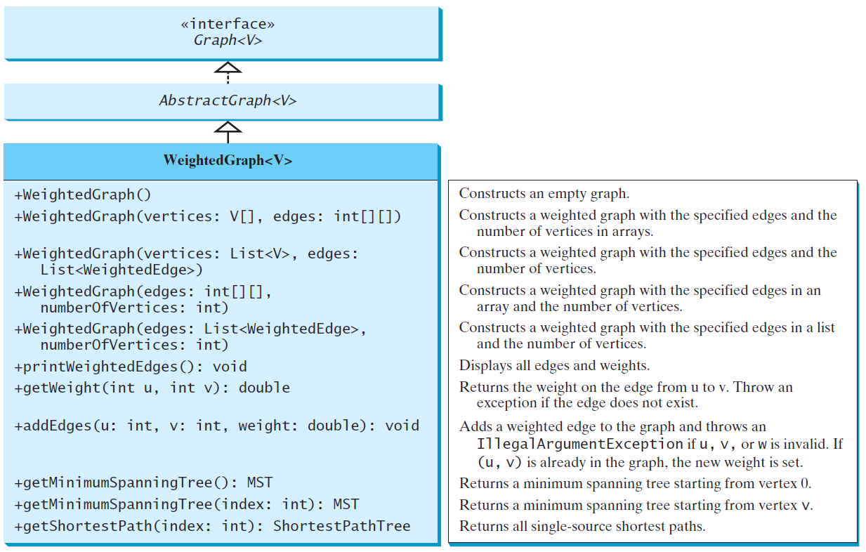
Edge Adjacency Lists
TestWeightedGraph
TestWeightedGraph
Graph
AbstractGraph
WeightedGraph

Slide 11
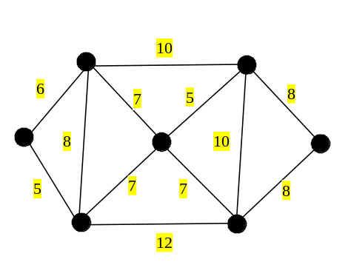
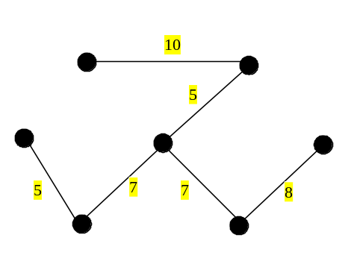
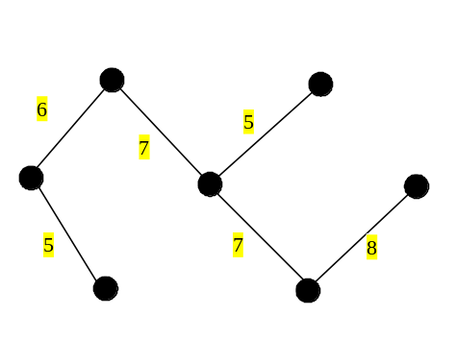
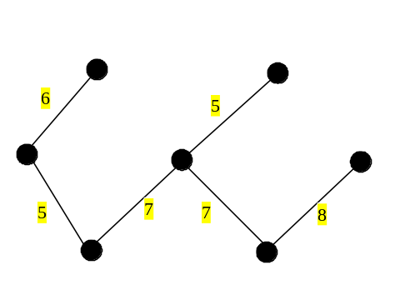
Minimum Spanning Trees
A graph may have many spanning trees. Suppose that the edges are weighted. A minimum spanning tree is a spanning tree with the minimum total weights. For example, the trees in Figures (b), (c), (d) are spanning trees for the graph in Figure (a). The trees in Figures (c) and (d) are minimum spanning trees.
Total w: 42
(b)
Total w: 38
(a)
Total w: 38
(d)
(c)

Slide 12
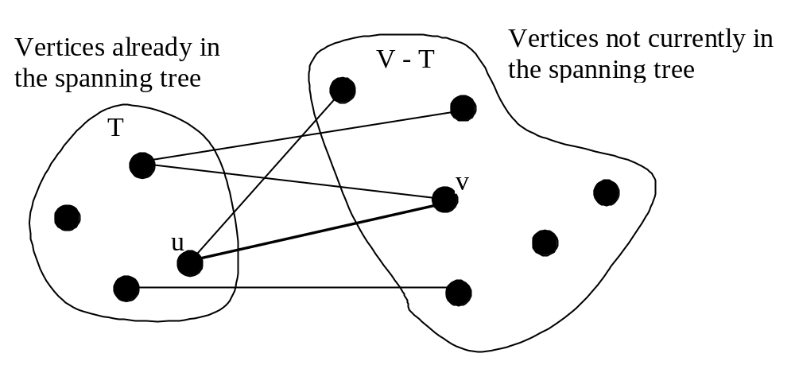
Prim’s Minimum Spanning Tree Algorithm
Input: G = (V, E, W). Output: a MST
Tree minimumSpanningTree() {
Let V denote the set of vertices in the graph;
Let T be a set for the vertices in the spanning tree;
Initially, add the starting vertex to T;
while (size of T < n) {
find u in T and v in V – T with the smallest weight
on the edge (u, v), as shown in the figure;
add v to T;
}
}

Slide 13
Minimum Spanning Tree Algorithm

Slide 14
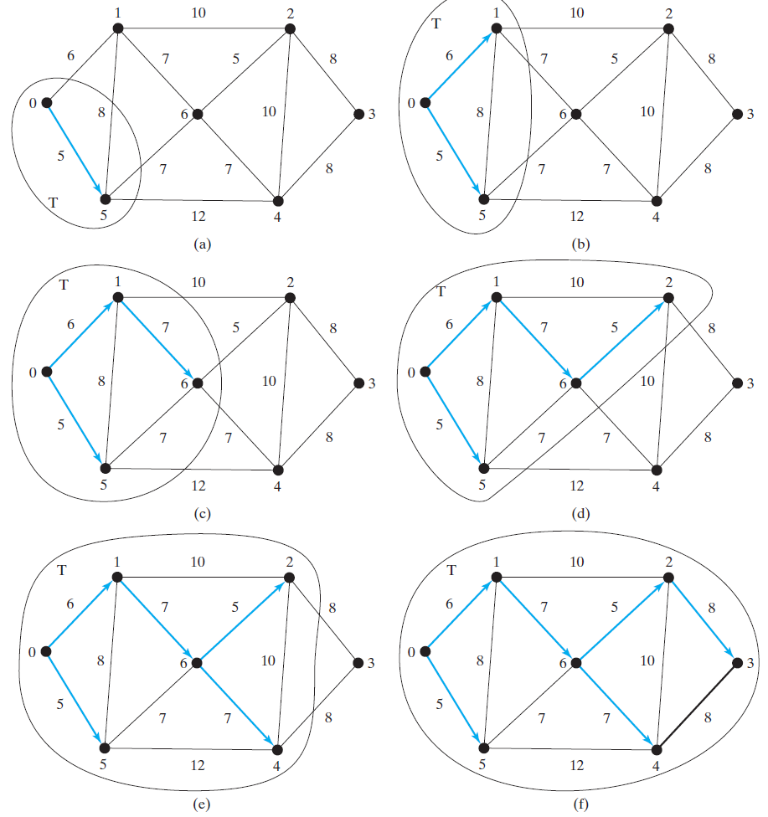
Minimum Spanning Tree Algorithm Example

Slide 15
Refined Version of Prim’s Minimum Spanning Tree Algorithm
Input: a graph G = (V, E) with non-negative weights
Output: a minimum spanning tree with the starting vertex s as the root
1 MST getMinimumSpanngingTree(s) {
2 Let T be a set that contains the vertices in the spanning tree;
3 Initially T is empty;
4 Set cost[s] = 0; and cost[v] = infinity for all other vertices in V;
5
6 while (size of T < n) {
7 Find u not in T with the smallest cost[u];
8 Add u to T;
9 for (each v not in T and (u, v) in E)
10 if (cost[v] > w(u, v)) {
11 cost[v] = w(u, v); parent[v] = u;
12 }
13 }

Slide 16
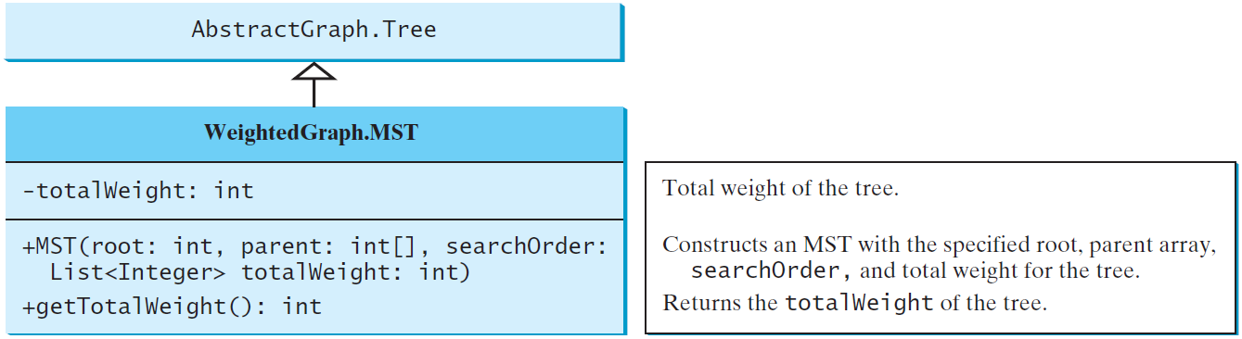
Implementing MST Algorithm

Slide 17
Time Complexity
Note that testing whether a vertex i is in T by invoking T.conatins(i) takes O(n) time, since T is a list. Therefore, the overall time complexity for this implemention is O(n³). Interested readers may see Programming Exercise 29.20 for improving the implementation and reduce the complexity to O(n²).

Slide 18
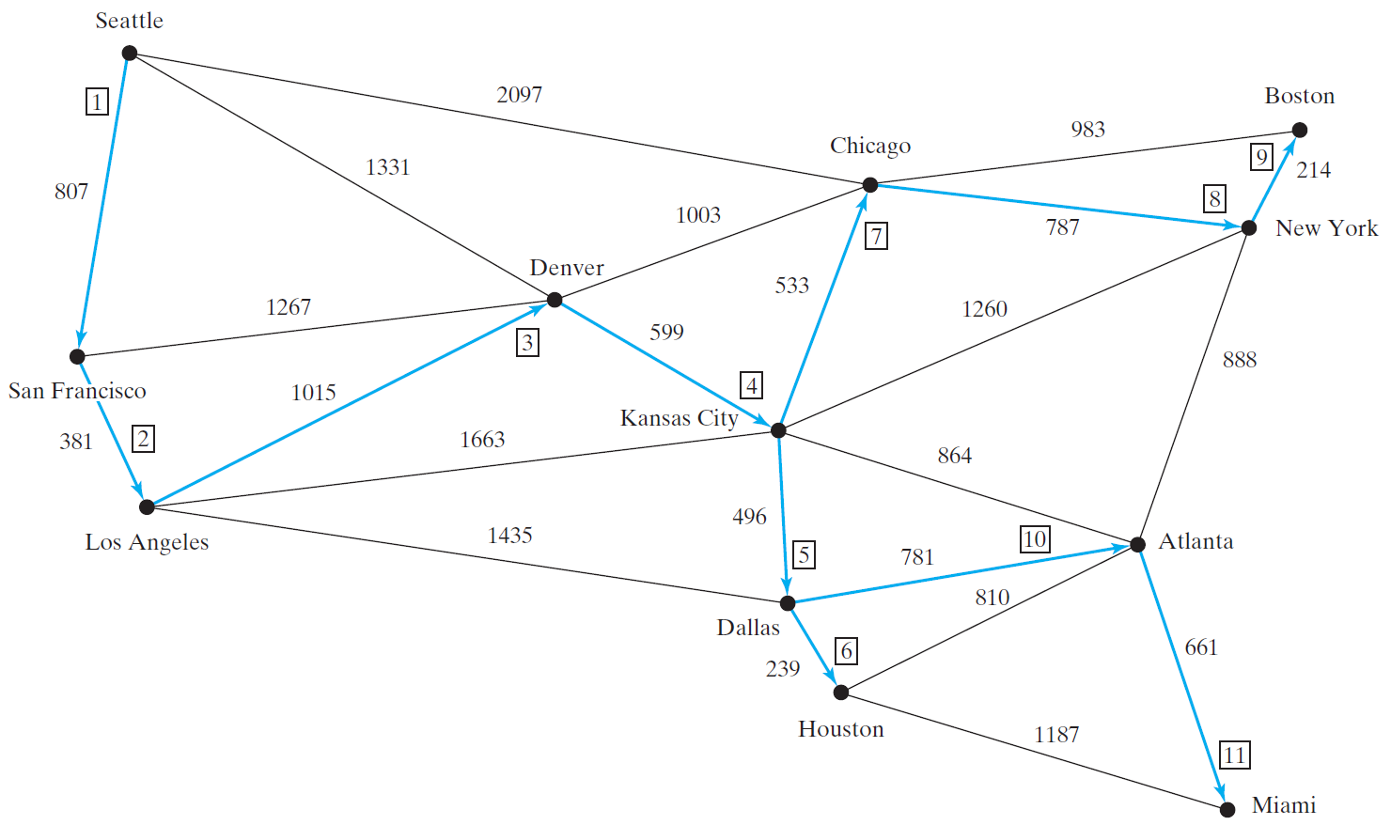
Test MST
TestMinimumSpanningTree
TestMinimumSpanningTree

Slide 19
Shortest Path
§29.1 introduced the problem of finding the shortest distance between two cities for the graph in Figure 29.1. The answer to this problem is to find a shortest path between two vertices in the graph.

Slide 20
Single Source Shortest Path Algorithm
Input: a graph G = (V, E) with non-negative weights
Output: a shortest path tree with the source vertex s as the root
1 ShortestPathTree getShortestPath(s) {
2 Let T be a set that contains the vertices whose
3 paths to s are known; Initially T is empty;
4 Set cost[s] = 0; and cost[v] = infinity for all other vertices in V;
5
6 while (size of T < n) {
7 Find u not in T with the smallest cost[u];
8 Add u to T;
9 for (each v not in T and (u, v) in E)
10 if (cost[v] > cost[u] + w(u, v)) {
11 cost[v] = cost[u] + w(u, v); parent[v] = u;
12 }
13 }
14 }

Slide 21
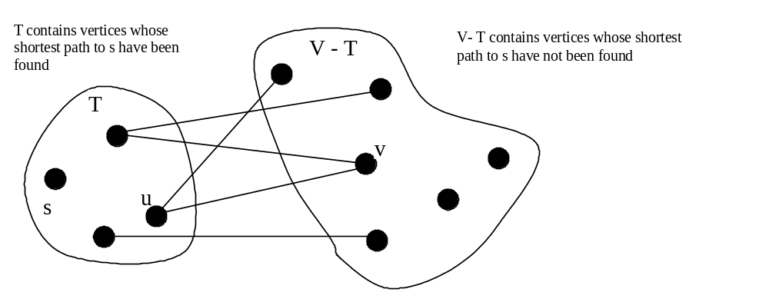
Single Source Shortest Path Algorithm

Slide 22
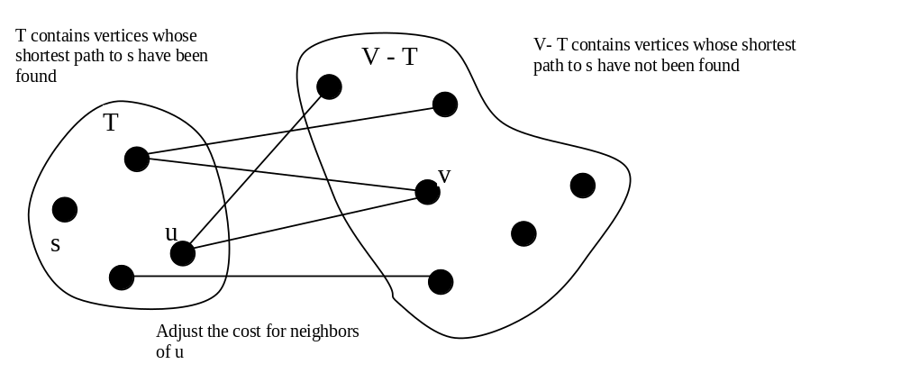
Single Source Shortest Path Algorithm

Slide 23
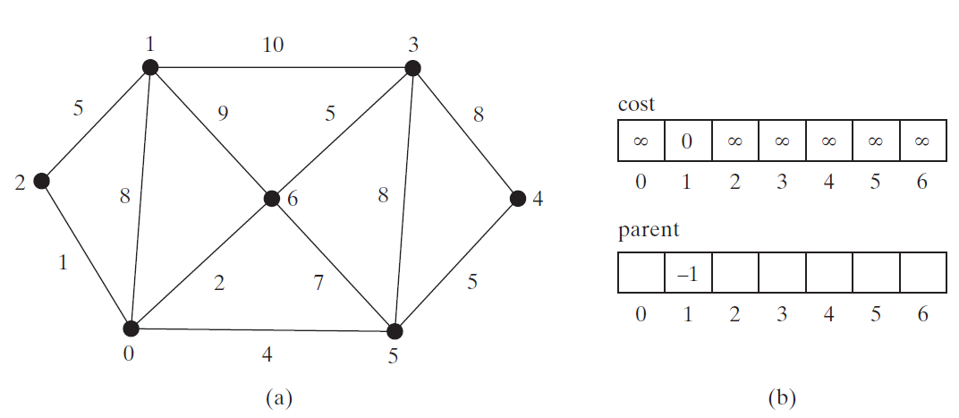
SP Algorithm Example (Step 0)

Slide 24
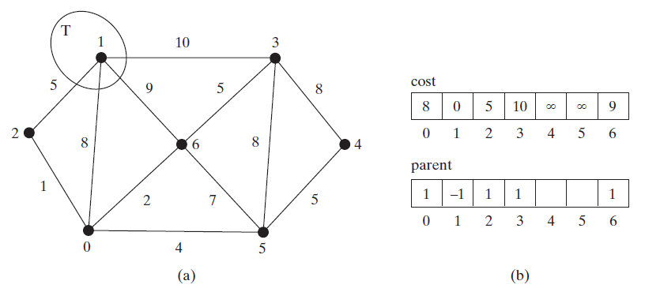
SP Algorithm Example (Step 1)

Slide 25
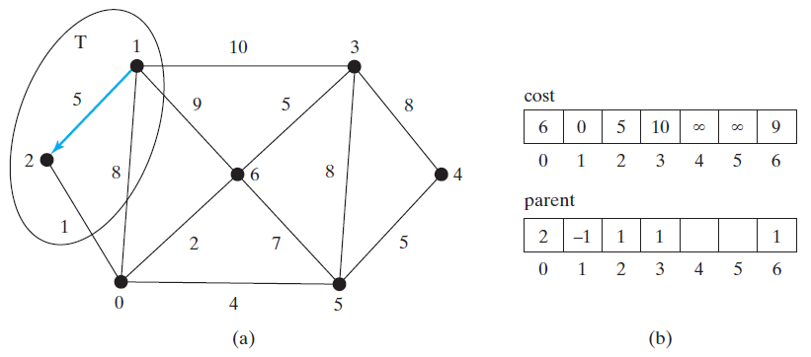
SP Algorithm Example (Step 2)

Slide 26
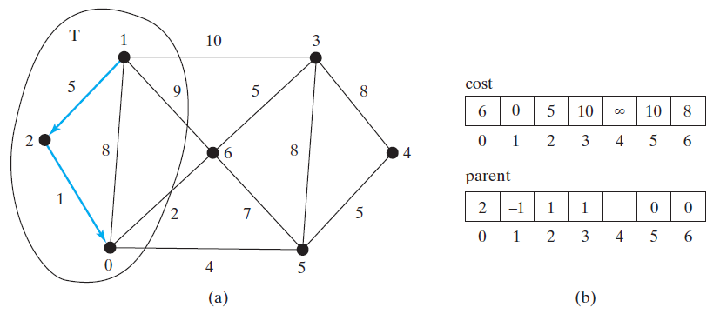
SP Algorithm Example (Step 3)

Slide 27
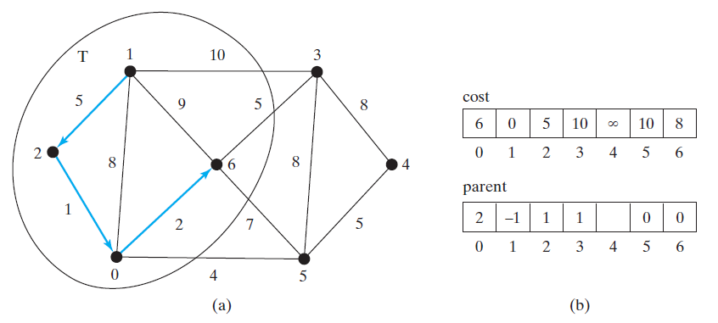
SP Algorithm Example (Step 4)

Slide 28
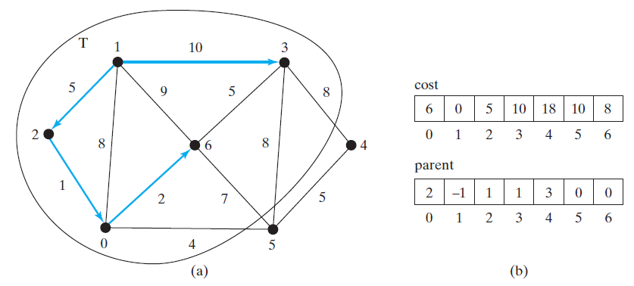
SP Algorithm Example (Step 5)

Slide 29
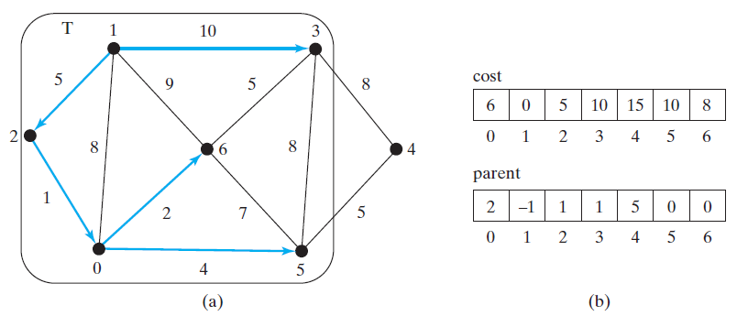
SP Algorithm Example (Step 6)

Slide 30
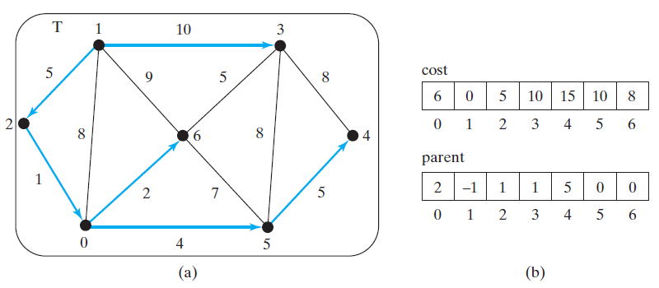
SP Algorithm Example (Step 7)

Slide 31
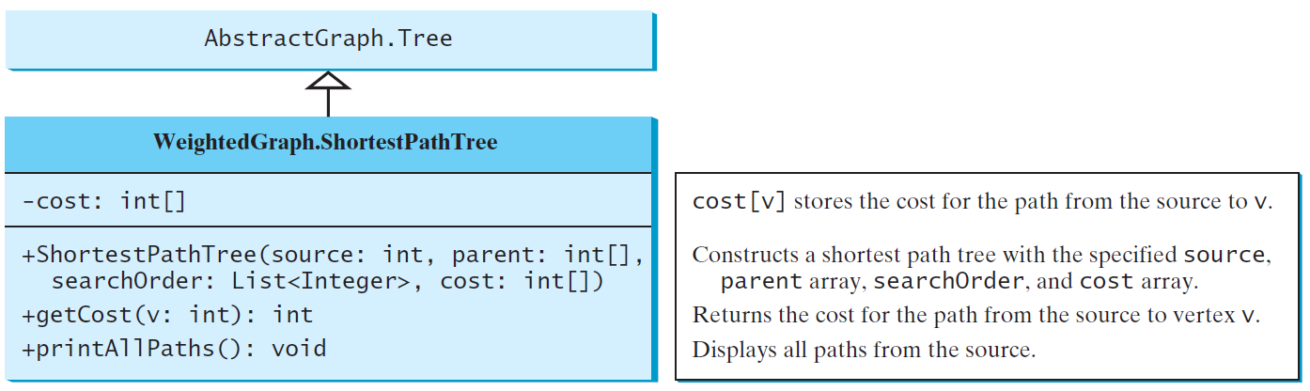
SP Algorithm Implementation
TestShortestPath
TestShortestPath

Slide 32
Time Complexity
Same as the Prim’s MST, O(n^3) and can be reduced to O(n^2).

Slide 33
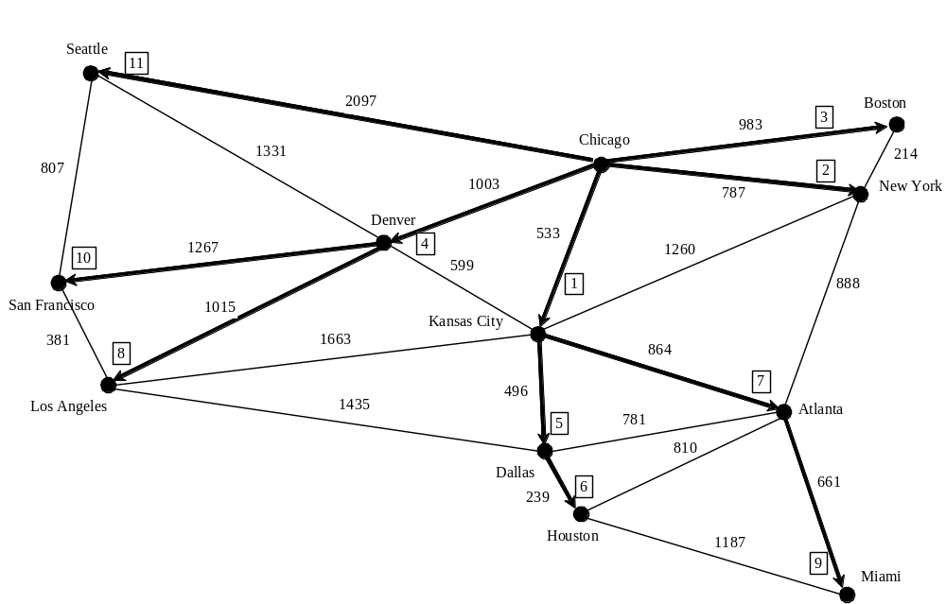
SP Algorithm Example

Slide 34
Shortest Path Animation
www.cs.armstrong.edu/liang/animation/ShortestPathAnimation.html

Slide 35
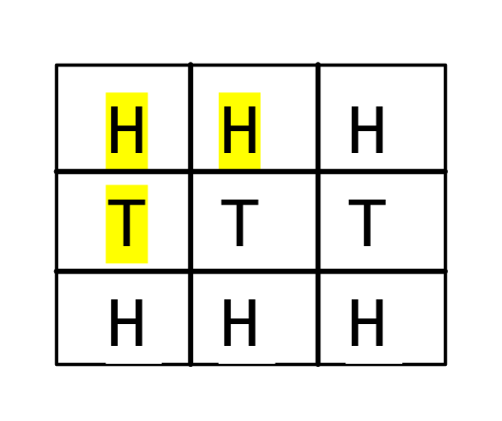
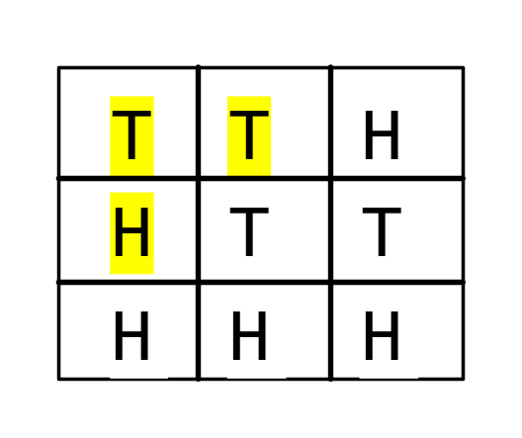
The Weighted Nine Tail Problem
The nine tail problem is to find the minimum number of the moves that lead to all coins face down. Each move flips a head coin and its neighbors. The weighted nine tail problem assigns the number of the flips as a weight on each move. For example, you can move from the coins in (a) to (b) by flipping the three coins. So the weight for this move is 3.
(a)
(b)

Slide 36
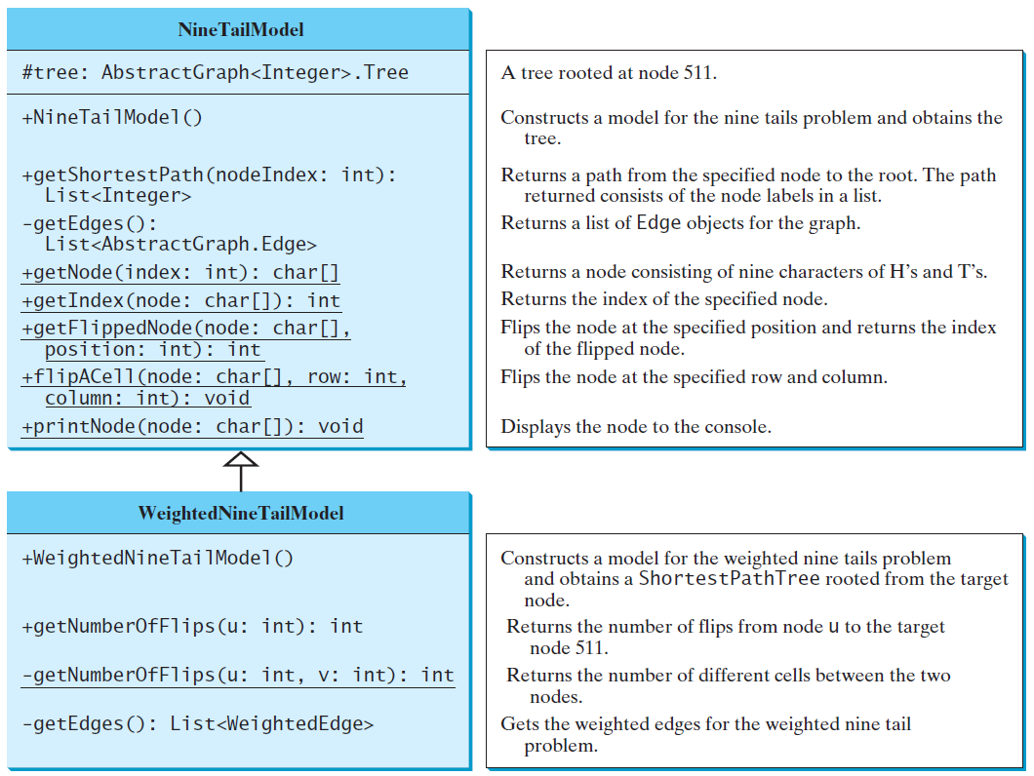
WeightedNineTailModel
NineTailModel
WeightedNineTailModel
WeightedNineTail

